Slide 1

Unit-4 MAC and Digital Signature
Information & Network Security (INS)
DU #2101CS622
Prof. Maulik D. Trivedi
Computer Engineering Department
maulik.trivedi@darshan.ac.in
9998 265 805

Slide 2

Looping
Outline
Message Authentication Codes - MAC
MAC requirements and security
MACs based on Hash Functions
MACs based on Block Ciphers
Digital Signature and its properties
Requirements and security
Various digital signature schemes
Elgamal and Schnorr
NIST digital Signature algorithm

Slide 3
Message Authentication
Message authentication is a procedure to verify that received message came from the genuine source and has not been altered.
Message authentication may also verify sequencing and timeliness.
Message authentication is a mechanism or service used to verify the integrity of a message.
Message authentication assures that data received are exactly same as sent (i.e., message contains no modification, no insertion, no deletion, or no replay).

Slide 4
Message Authentication Requirements
Disclosure: Release of message contents.
Traffic analysis: Analyses the traffic and observe the pattern of traffic between parties.
Masquerade: Insertion of messages into the network from a fraudulent source.
Content modification: Changes to the contents of a message.
Sequence modification: Any modification to a sequence of messages between parties.
Timing modification: Delay or replay of messages.
Source repudiation: Denial of transmission of message by source.
Destination repudiation: Denial of receipt of message by destination.

Slide 5
Message Authentication Requirements
Requires Message Confidentiality
Disclosure
Traffic analysis
Masquerade
Content modification
Sequence modification
Timing modification
Source repudiation
Destination repudiation
Requires Message Authentication
Requires Digital Signature

Slide 6
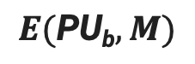
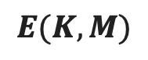
Message Authentication
Source A
Destination B
M
M
E
D
K
$$E(K,M)$$
K
(a) Symmetric encryption : Confidentiality and Authentication
M
M
E
D
PU_{b}
$$E(\text{PU}\text{b},M)$$
PR_{b}
(b) Public-key encryption : Confidentiality

Slide 7
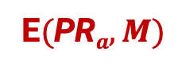
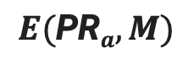


Message Authentication
M
M
E
D
PR_{a}
$$E(\text{PR}a,M)$$
PU_{a}
(c) Public-key encryption : Authentication and Signature
M
M
E
E
D
D
PR_{a}
PU_{b}
PR_{b}
PU_{a}
$$E(\text{PR}a,M)$$
E(PU_{b} ,E$(\text{PR}a,M))$
E$(\text{PR}a,M)$
(d) Public-key encryption : Confidentiality, Authentication and Signature

Slide 8
Message Authentication Code
An alternative authentication technique involves the use of a secret key to generate a small fixed-size block of data, known as a cryptographic checksum or MAC.
MAC is appended to the message. This technique assumes that two communicating parties, say A and B, share a common secret key K.
When A has a message to send to B, it calculates the MAC as a function of the message and the key.
MAC = C ( K , M )

Slide 9
Message Authentication Code
The receiver is assured that the message has not been altered.
If an attacker alters the message but does not alter the MAC, then the receiver’s calculation of the MAC will differ from the received MAC.
Source A
Destination B
M
M
C
K
ll
Compare
K
C
C(K, M)
(a) Message authentication

Slide 10
Message Authentication Code
The receiver is assured that the message is from the alleged sender.
Because no one else knows the secret key, no one else could prepare a message with a proper MAC.
A MAC function is similar to encryption. One difference is that the MAC algorithm need not be reversible, as it must be for decryption.

Slide 11
Message Authentication Code
Source A
Destination B
M
M
C
K₁
ll
E
D
Compare
K₁
K₂
K₂
C
E(K₂, [M||C(K₁, M)])
C(K₁, M)
(b) Message authentication and confidentiality;
authentication tied to plaintext
E(K₂, M)
M
D
M
E
ll
C
K₁
Compare
K₂
K₂
K₁
C
C(K₁, E(K₂, M))
(c) Message authentication and confidentiality;
authentication tied to ciphertext

Slide 12
MAC Based on Hash Functions - HMAC
Cryptographic hash functions such as MD5 and SHA generally execute faster in software than symmetric block ciphers such as DES.
Library code for cryptographic hash functions is widely available.

Slide 13
Design objectives for HMAC
To use available hash functions without modifications.
To allow for easy replaceability of the embedded hash function in case faster or more secure hash functions are found or required.
To preserve the original performance of the hash function without incurring a significant degradation..
To use and handle keys in a simple way.
To have a well understood cryptographic analysis of the strength of the authentication mechanism based on reasonable assumptions about the embedded hash function.

Slide 14
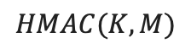
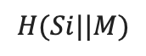
K⁺
ipad
HMAC Structure
Append zeros to the left end of K to create a b-bit string K⁺
XOR K⁺ with ipad to produce the b-bit block S_{i}.
Append M to S_{i}.
Apply H to the stream generated in step 3.
XOR K⁺ with opad to produce the b-bit block S₀.
Append the hash result from step 4 to S₀.
Apply H to the stream generated in step 6 and output the result.
b bits
b bits
…
b bits
S_{i} | Y₀ | Y₁
Y_{L-1}
n bits
Hash
IV
n bits
K⁺
opad
$$H(Si||M)$$
Pad to b bits
n bits
S_{o}
n bits
Hash
IV
n bits
$$HMAC(K,M)$$

Slide 15
HMAC Structure
H = Embedded hash function (e.g. MD5, SHA-1, RIPEMD-160).
IV = Initial value that is input to hash function.
M = Message input to HMAC.
Y_{i} = i ^{th} block of M.
L = Number of blocks in M.
N = Length of hash code produced by embedded hash function.
K ⁺ = K padded with zeros on the left so that the result is b bits in length.
ipad = 00110110 (36 in hexadecimal) repeated b/8 times.
opad = 01011100 (5C in hexadecimal) repeated b/8 times.

Slide 16
MAC based on Block Ciphers
The Data Authentication Algorithm (DAA) based on DES, has been one of the most widely used MACs for a number of years.
The algorithm can be defined as using the cipher block chaining (CBC) mode of operation of DES with an initialization vector of zero.
P₁
P₂
P_{N}
IV
C_{N-1}
K
K
…
K
Encrypt
Encrypt
Encrypt
C₁
C₂
C_{N}

Slide 17
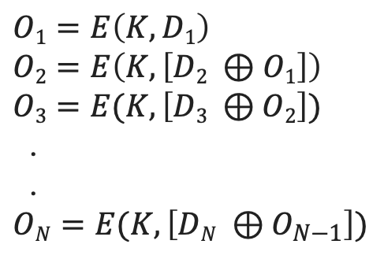
Data Authentication Algorithm (DAA)
Time = 1
Time = 2
Time = N
D₁
(64 bits)
D₂
D_{N}
K
DES
Encrypt
K
DES
Encrypt
K
DES
Encrypt
(56 bits)
…
$$O1=E\left(K, D1\right)$$
$$O2=E\left(K, \left[D2 ⊕O1\right]\right)$$
$O3=E(K,\left[D3 ⊕O2\right])$
.
.
$ON=E(K,\left[DN ⊕O_{N−1}\right])$
O₁
(64 bits)
O₂
O_{N}

Slide 18
Data Authentication Algorithm (DAA)
The data (e.g. message, record, file, or program) to be authenticated are grouped into contiguous 64-bit blocks D₁, D₂, …, D_{n}.
If necessary, the final block is padded on the right with zeroes to form a full 64-bit block.
Using the DES encryption algorithm E and a secret key K, a data authentication code (DAC) is calculated.

Slide 19
Cipher-Based Message Authentication Code (CMAC)
Cipher-based Message Authentication Code (CMAC) mode of operation for use with AES and triple DES.
First, let us define the operation of CMAC when the message is an integer multiple of n of the cipher block length b.
For AES, b = 128, and for triple DES, b = 64. The message is divided into n blocks (M₁, M₂,…, M_{n}).

Slide 20
Cipher-Based Message Authentication Code (CMAC)
The algorithm makes use of a k-bit encryption key K and a b-bit constant K₁.
For AES, the key size k is 128, 192 or 256 bits.
For triple DES, the key size is 112 or 168 bits.

Slide 21
Cipher-Based Message Authentication Code (CMAC)
…
M₁
M₂
M_{n}
b
K₁
k
K
Encrypt
K
Encrypt
K
Encrypt
(a) Message length is integer multiple of block size
MSB(Tlen)
T
…
M₁
M₂
M_{n} 10..0
K₂
K
Encrypt
K
Encrypt
K
Encrypt
(b) Message length is not integer multiple of block size
MSB(Tlen)
T

Slide 22
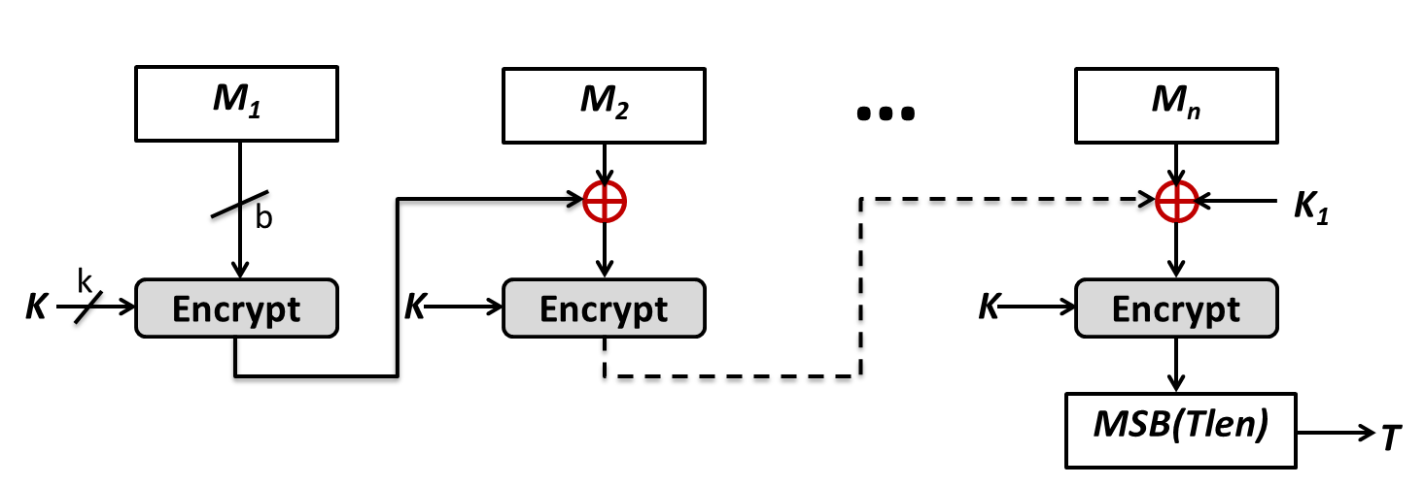
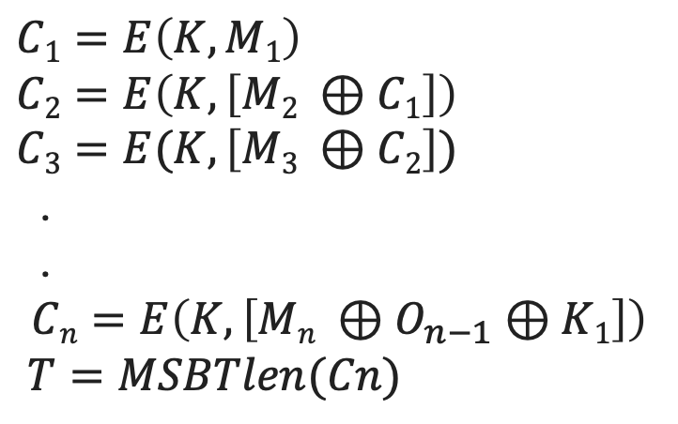
Cipher-Based Message Authentication Code (CMAC)
$$C1=E\left(K, M1\right)$$
$$C2=E\left(K, \left[M2 ⊕C1\right]\right)$$
$C3=E(K,\left[M3 ⊕C2\right])$
.
.
$$Cn=E\left(K, \left[Mn ⊕O_{n−1}⊕K1\right]\right)$$
$T=MSBTlen(Cn)$

Slide 23
Cryptographic Goals
Cryptographic Goals
Confidentiality
Data Integrity
Authentication
Non-repudiation
Symmetric-key
ciphers:
Block ciphers
Stream ciphers
Public-key
ciphers
Arbitrary length
hash functions
Message
Authentication
Codes (MACs)
Digital Signatures
Entity Authentication
Authentication Primitives
Message Authentication
MACS
Digital Signatures
Digital Signatures
Notes:
Проверить правильность схемы

Slide 24
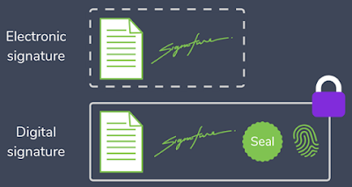
Digital Signature
A digital signature is an authentication mechanism that enables the creator of a message to attach a code that acts as a signature.
Typically the signature is formed by taking the hash of the message and encrypting the message with the creator’s private key.
The signature guarantees the source and integrity of the message.
The digital signature standard (DSS) is an NIST standard that uses the secure hash algorithm (SHA).

Slide 25



Bob’s Public key
Bob
Alice
Message M
Message M
S
Cryptographic
Hash function
Cryptographic
Hash function
Decrypt
Bob’s Private key
h
h
h’
Encrypt
Compare
S
Return Signature
valid or not valid
Bob’s Signature for M

Slide 26
Hash Code, MAC and Digital Signature
Hash Code
A hash of the message, if appended to the message itself, only protects against accidental changes to the message, as an attacker who modifies the message can simply calculate a new hash and use it instead of the original one. So this only gives integrity.
MAC
A message authentication code (MAC) (sometimes also known as keyed hash) protects against message forgery by anyone who doesn't know the secret.
This means that the receiver can forge any message – thus we have both integrity and authentication (as long as the receiver doesn't have a split personality), but not non-repudiation.

Slide 27
Hash Code, MAC and Digital Signature
Digital Signature
A digital signature is created with a private key, and verified with the corresponding public key of an asymmetric key-pair.
Only the holder of the private key can create this signature, and normally anyone knowing the public key can verify it. So digital signature provides non-repudiation.

Slide 28
Attacks
C = Attacker, A = Victim
Key-only attack: C only knows A’s public key.
Known message attack: C has set of messages, signatures.
Generic chosen message attack: C obtains A’s signatures on messages selected without knowledge of A’s public key.
Directed chosen message attack: C obtains A’s signatures on messages selected after knowing A’s public key.
Adaptive chosen message attack: C may request signatures on messages depending upon previous message-signature pairs.

Slide 29
Forgeries
Total break: C determines A’s private key.
Universal forgery: C finds an efficient signing algorithm that provides an equivalent way of constructing signatures on arbitrary messages.
Selective forgery: C forges a signature for a particular message chosen by C.
Existential forgery: C forges a signature for a particular message not chosen by C. Consequently, this forgery may only be a minor nuisance to A.

Slide 30
Digital Signature Requirements
The signature must be a bit pattern that depends on the message being signed.
The signature must use some information unique to the sender to prevent both forgery and denial.
It must be relatively easy to produce the digital signature.
It must be relatively easy to recognize and verify the digital signature.
It must be computationally infeasible to forge a digital signature, either by constructing a new message for an existing digital signature or by constructing a fraudulent digital signature for a given message.
It must be practical to retain a copy of the digital signature in storage.

Slide 31
Digital Signature Standard / DSA
The DSS uses an algorithm that is designed to provide only the digital signature function.
Unlike RSA, it cannot be used for encryption or key exchange.

Slide 32
RSA Approach
In the RSA approach, the message to be signed is input to a hash function that produces a secure hash code of fixed length.
This hash code is then encrypted using the sender’s private key to form the signature.
Both the message and the signature are then transmitted.
The recipient takes the message and produces a hash code.
M
M
H
PR_{a}
ll
PU_{a}
Compare
H
E
D
E(PR_{a}, H(M))

Slide 33
RSA Approach
The recipient also decrypts the signature using the sender’s public key.
If the calculated hash code matches the decrypted signature, the signature is accepted as valid.
Because only the sender knows the private key, only the sender could have produced a valid signature.

Slide 34
DSA Approach
The hash code is provided as input to a signature function along with a random number K generated for this particular signature.
The signature function also depends on the sender’s private key (PR_{a}) and a set of parameters known to a group of communicating principals.
We can consider this set to constitute a global public key (PU_{G})
The result is a signature consisting of two components, labelled as s and r.
M
M
H
ll
PU_{G}
PR_{a}
PU_{G}
PU_{a}
s
r
H
Sig
Ver
Compare
K

Slide 35
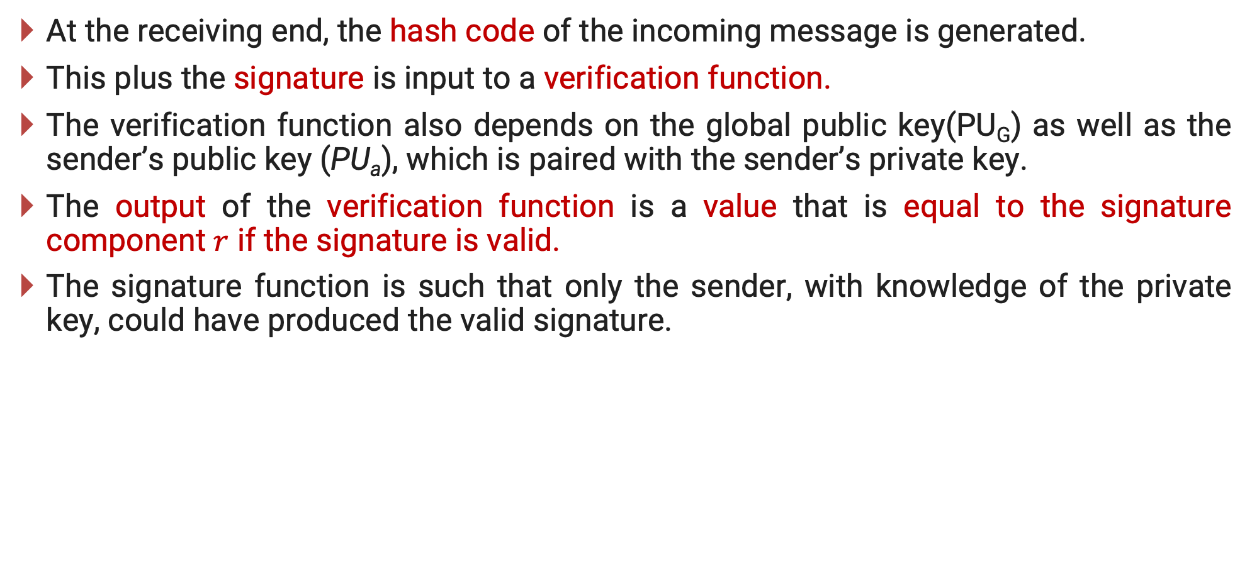
DSA Approach
At the receiving end, the hash code of the incoming message is generated.
This plus the signature is input to a verification function.
The verification function also depends on the global public key(PU_{G}) as well as the sender’s public key (PU_{a}), which is paired with the sender’s private key.
The output of the verification function is a value that is equal to the signature component $r$ if the signature is valid.
The signature function is such that only the sender, with knowledge of the private key, could have produced the valid signature.

Slide 36
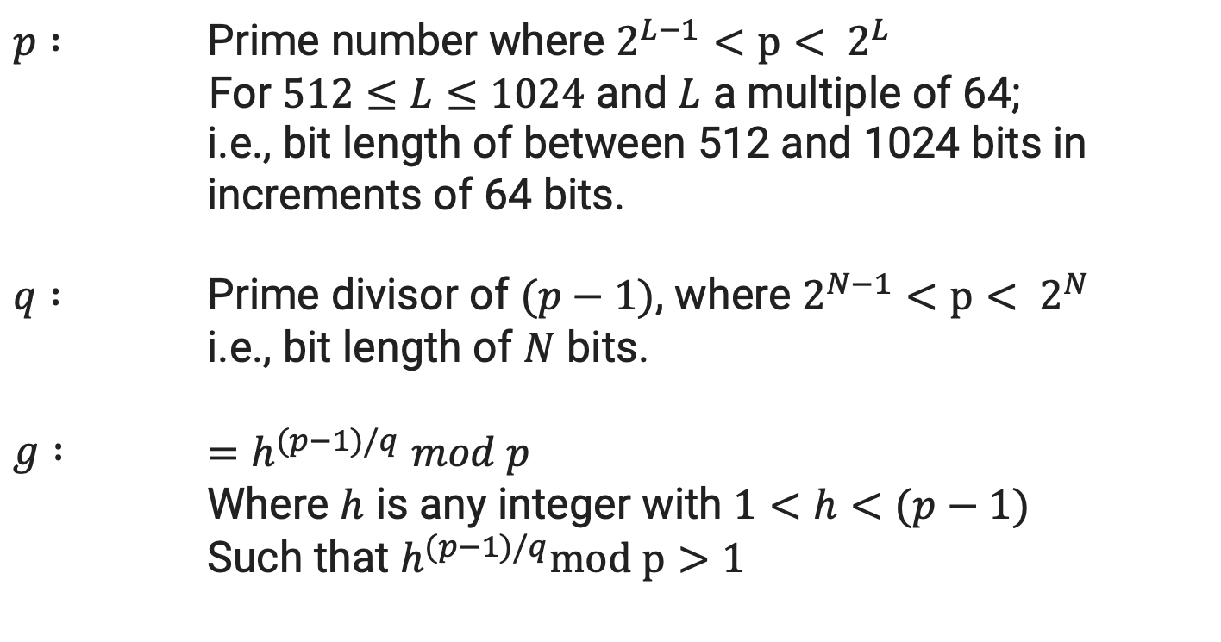
Digital Signature Algorithm
Global Public-Key Components
$$p :$$ | Prime number where $2^{L−1}<p< 2^{L}$ For $512≤L≤1024$ and $L$ a multiple of 64; i.e., bit length of between 512 and 1024 bits in increments of 64 bits.
$$q :$$ | Prime divisor of $(p−1)$, where $2^{N−1}<p< 2^{N}$ i.e., bit length of $N$ bits.
$$g :$$ | $=h^{(p−1)/q}$ $mod p$ Where $h$ is any integer with $1<h<(p−1)$ Such that $h^{(p−1)/q}mod p>1$

Slide 37
Digital Signature Algorithm
User’s Private key
$$x$$ | Random or pseudorandom integer with $0<x<q$
User’s Public key
$$y$$ | $$=g^{x }mod p$$
User’s Per-Message Secret Number
$$k$$ | Random or pseudorandom integer with $0<k<q$

Slide 38
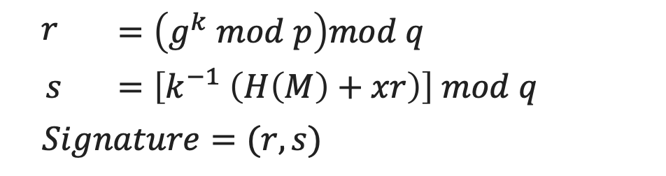
Digital Signature Algorithm
Signing
$$r$$ | $$=\left(g^{k} mod p\right)mod q$$
$$s$$ | $$=\left[k^{−1} \left(H\left(M\right)+xr\right)\right] mod q$$
$$Signature=(r, s)$$
M
ll
M
H
PU_{G}
PR_{a}
PU_{G}
PU_{a}
s
r
H
Sig
Ver
Compare
k

Slide 39
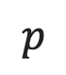
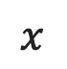
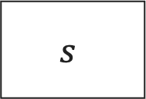
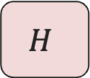
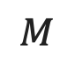

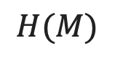
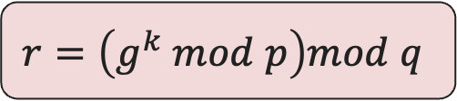
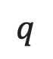
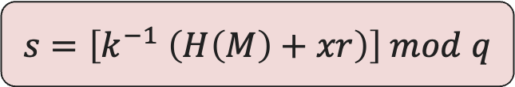
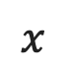
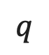
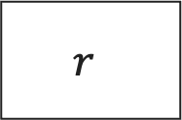
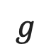
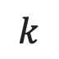
DSA Signing
$$M$$
$$M$$
$$p$$
$$q$$
$$g$$
$$k$$
$$r=\left(g^{k} mod p\right)mod q$$
$$q$$
$$r$$
$$H$$
$$s=\left[k^{−1} \left(H\left(M\right)+xr\right)\right] mod q$$
$$H(M)$$
$$s$$
$$x$$
$$x$$

Slide 40
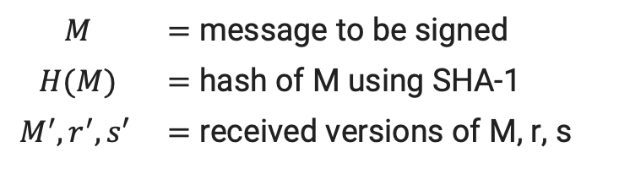
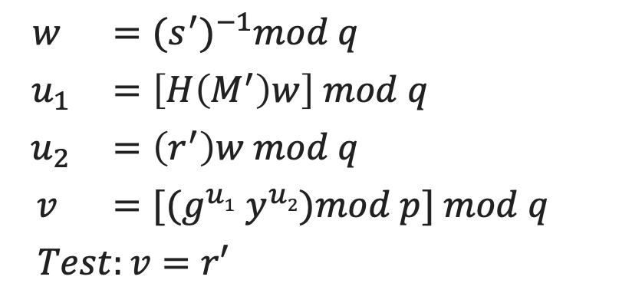
Digital Signature Algorithm
Verifying
$$w$$ | $$={(s^{′})}^{−1}mod q$$
$$u_{1}$$ | $$=\left[H\left(M^{′}\right)w\right] mod q$$
$$u_{2}$$ | $$=\left(r^{′}\right)w mod q$$
$$v$$ | $=[(g^{u1}$ $y^{u2})mod p] mod q$
$$Test:v=r′$$
$$M$$ | $=$ message to be signed
$$H(M)$$ | $=$ hash of M using SHA-1
$$M^{′}, r^{′},s′$$ | $=$ received versions of M, r, s
M
ll
M
H
PU_{G}
PR_{a}
PU_{G}
PU_{a}
s
r
H
Sig
Ver
Compare
k

Slide 41
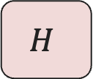

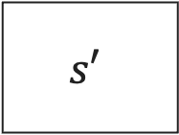
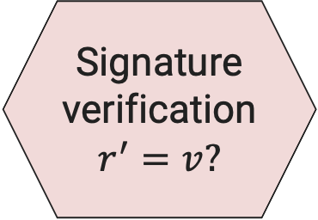
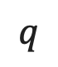

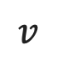
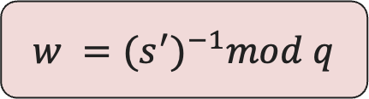
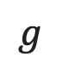
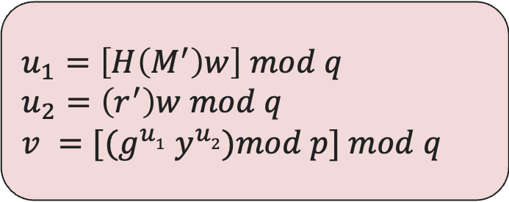

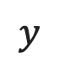
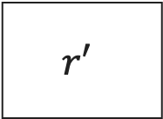
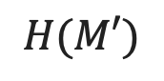
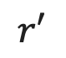
DSA Verifying
$$y$$
$$q$$
$$g$$
$$M′$$
$$u_{1}=\left[H\left(M^{′}\right)w\right] mod q$$
$$u_{2}=\left(r^{′}\right)w mod q$$
$$v =[(g^{u1} y^{u2})mod p] mod q$$
$$H$$
$$H(M′)$$
$$w$$
$$r′$$
$$v$$
Signature verification
$$r^{′}=v?$$
$$r′$$
$$q$$
$$s′$$
$$w ={(s^{′})}^{−1}mod q$$

Slide 42
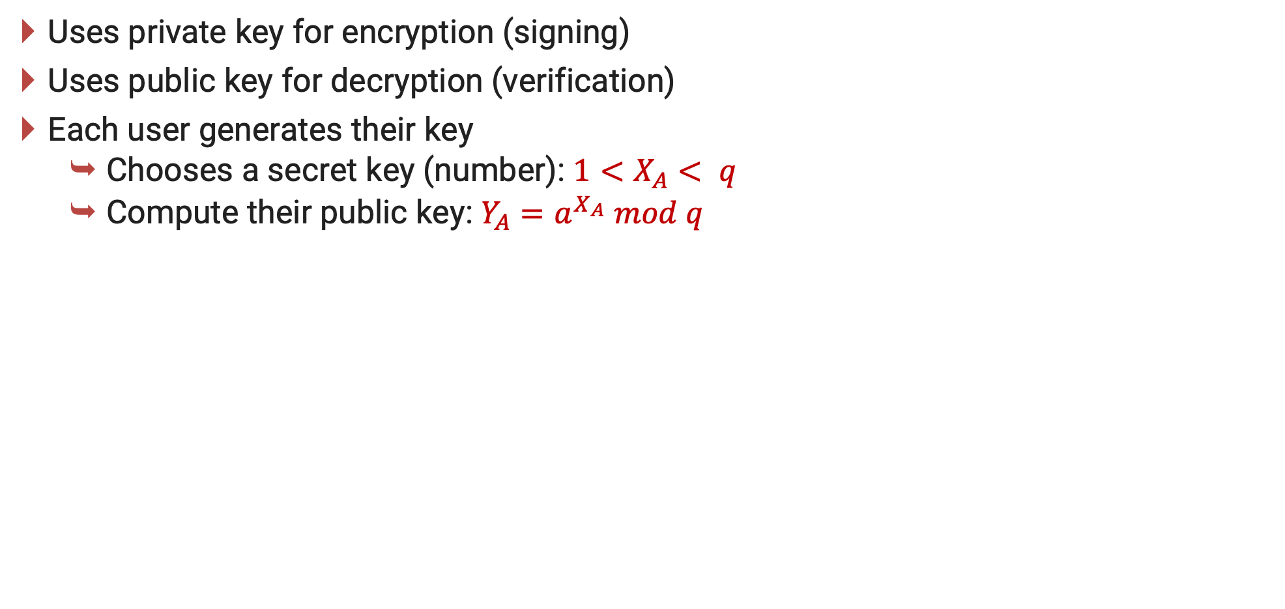
ElGamal Digital Signatures
Uses private key for encryption (signing)
Uses public key for decryption (verification)
Each user generates their key
Chooses a secret key (number): $1<X_{A}< q$
Compute their public key: $Y_{A}=a^{X_{A}} mod q$
Notes:
Recall from Chapter 10, that in 1984, T. Elgamal announced a public-key scheme based on discrete logarithms, closely related to the Diffie-Hellman technique [ELGA84, ELGA85]. The ElGamal encryption scheme is designed to enable encryption by a user's public key with decryption by the user's private key. The ElGamal signature scheme involves the use of the private key for encryption and the public key for decryption. The ElGamal cryptosystem is used in some form in a number of standards including the digital signature standard (DSS) and the S/MIME email standard. As with Diffie-Hellman, the global elements of ElGamal are a prime number q and a, which is a primitive root of q. User A generates a private/public key pair as shown. The security of ElGamal is based on the difficulty of computing discrete logarithms, to recover either x given y, or k given K (next slide).

Slide 43
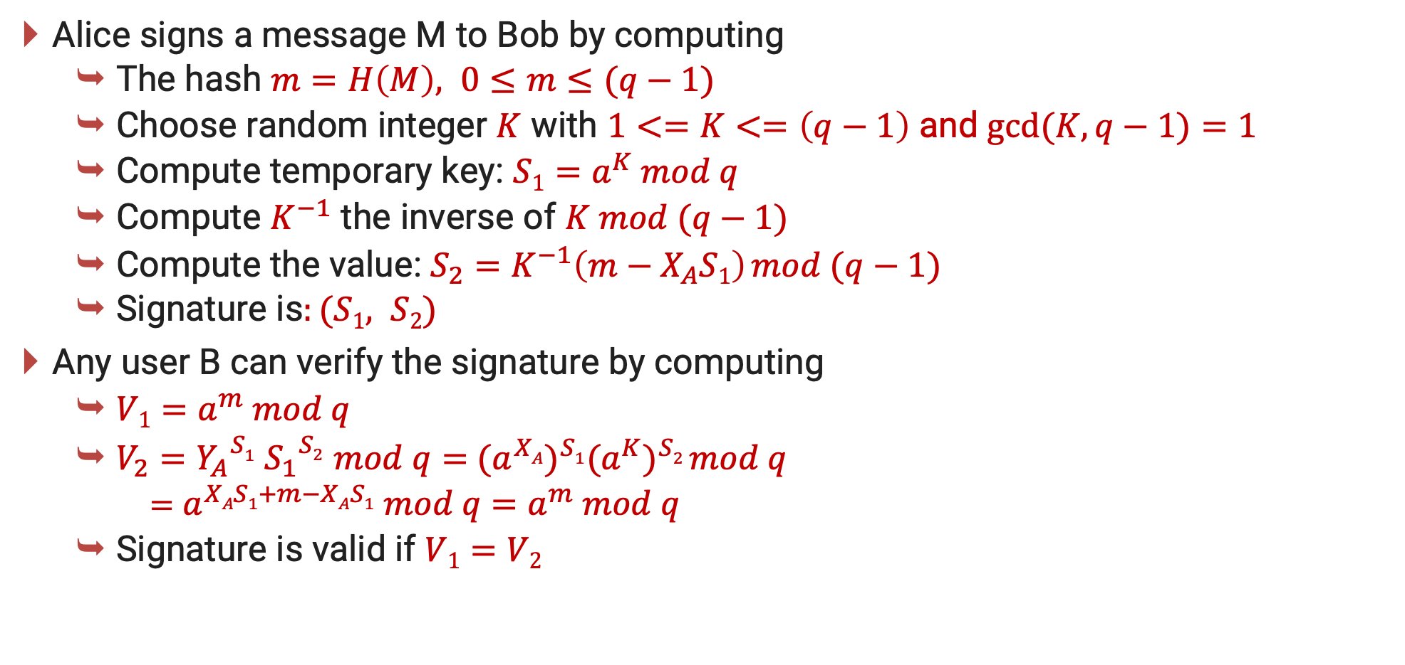
ElGamal Digital Signature
Alice signs a message M to Bob by computing
The hash $m=H\left(M\right), 0≤m≤(q−1)$
Choose random integer $K$ with $1<=K<=\left(q−1\right)$ and $gcd⁡(K, q−1)=1$
Compute temporary key: $S1=a^{K} mod q$
Compute $K^{−1}$ the inverse of $K mod (q−1)$
Compute the value: $S_{2}=K^{−1}\left(m−X_{A}S1\right) mod (q−1)$
Signature is$:(S1, S2)$
Any user B can verify the signature by computing
$V1=a^{m} mod q$
$V_{2}={Y_{A}}^{S1}$ ${S_{1}}^{S2}$ $mod q=$ ${{(a}^{XA})}^{S1}{{(a}^{K})}^{S2} mod q$
$=$ $a^{XAS1+m−XAS1}$ $mod q$ $=a^{m} mod q$
Signature is valid if $V1=V2$
Notes:
To sign a message M, user A first computes the hash m = H(M), such that m is an integer in the range 0 <= m <= q – 1. A then forms a digital signature as shown.
The basic idea with El Gamal signatures is to again choose a temporary random signing key, protect it, then use it solve the specified equation on the hash of the message to create the signature (in 2 pieces). Verification consists of confirming the validation equation that relates the signature to the (hash of the) message (see text for proof). Again note that El Gamal encryption involves 1 modulo exponentiation and multiplications (vs 1 exponentiation for RSA).

Slide 44
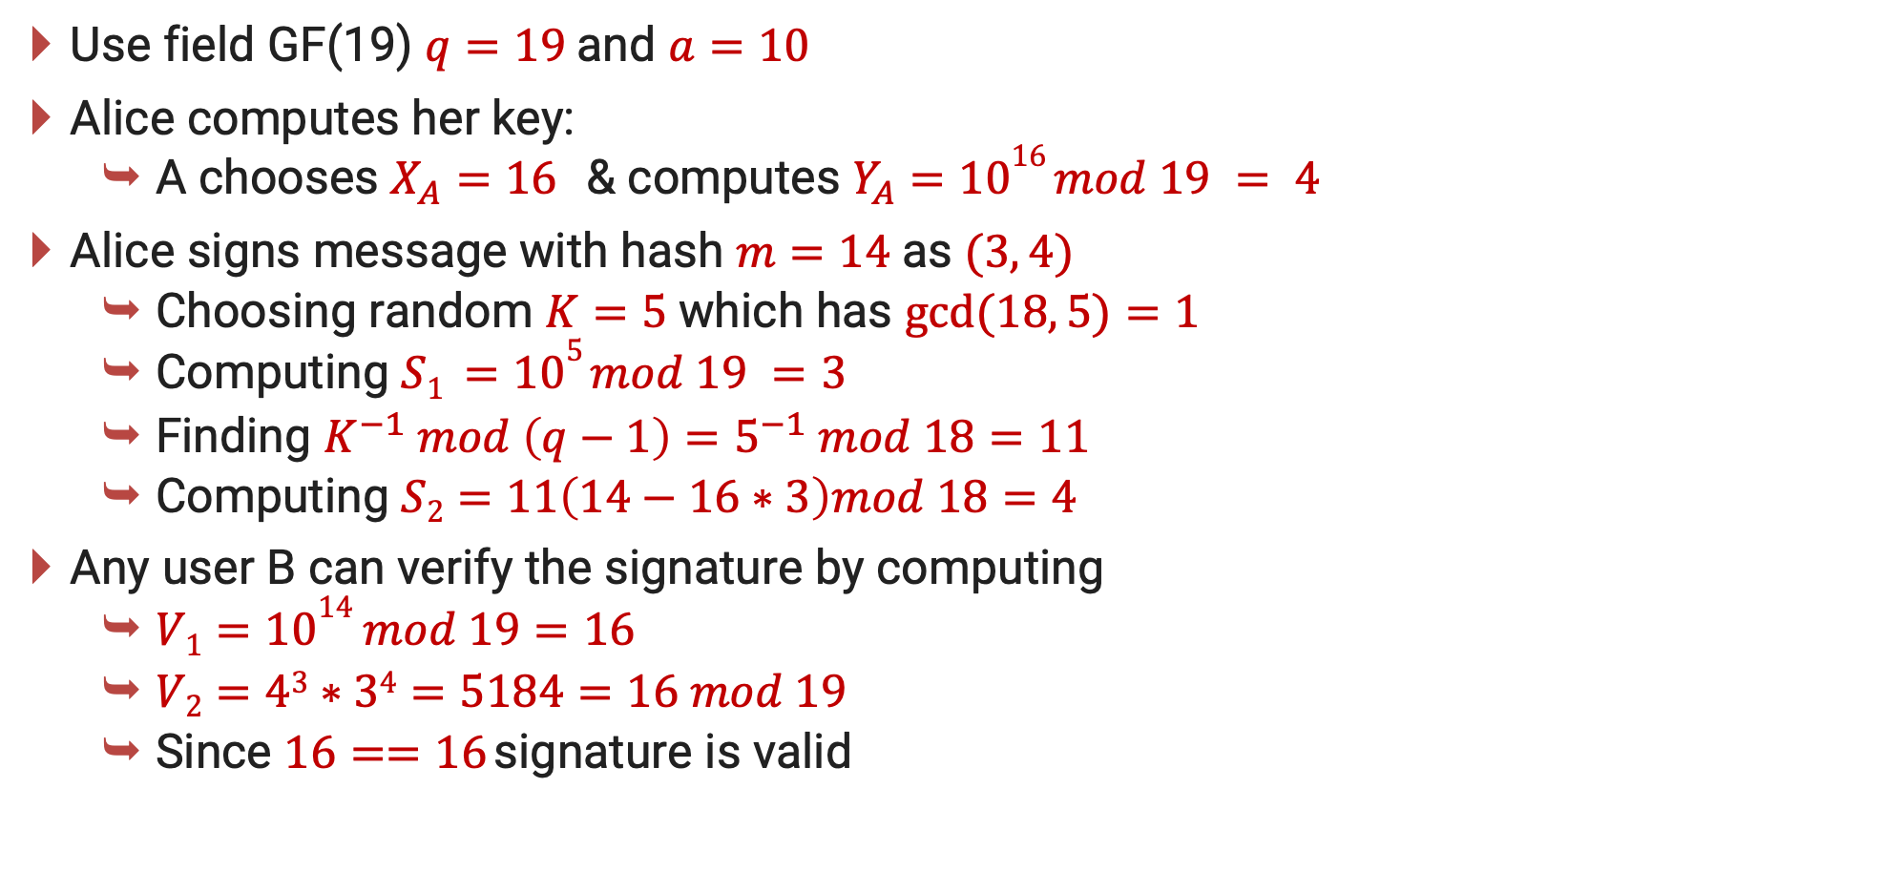
ElGamal Signature Example
Use field GF(19) $q=19$and $a=10$
Alice computes her key:
A chooses $X_{A}=16$ & computes $Y_{A}=1016 mod 19 = 4$
Alice signs message with hash $m=14$as $(3, 4)$
Choosing random $K=5$which has $gcd⁡(18, 5)=1$
Computing $S1 =105 mod 19 =3$
Finding $K^{−1} mod \left(q−1\right)=5^{−1} mod 18=11$
Computing $S2=11\left(14−16∗3\right)mod 18=4$
Any user B can verify the signature by computing
$V1=1014 mod 19=16$
$V2=43∗34=5184=16 mod 19$
Since $16==16$signature is valid
Notes:
Here is an example of creating and verifying an ElGamal signature from the text using the prime field GF(19); that is, q = 19. It has primitive roots {2, 3, 10, 13, 14, 15}, as shown in Table 8.3. We choose a = 10. Alice generates a key pair as shown, which is = {19, 10, 4}. Alice can sign a message with hash m = 14 as shown to compute the signature pair (3,4). Any user B can verify the signature by computing confirming the validation equation as shown.

Slide 45
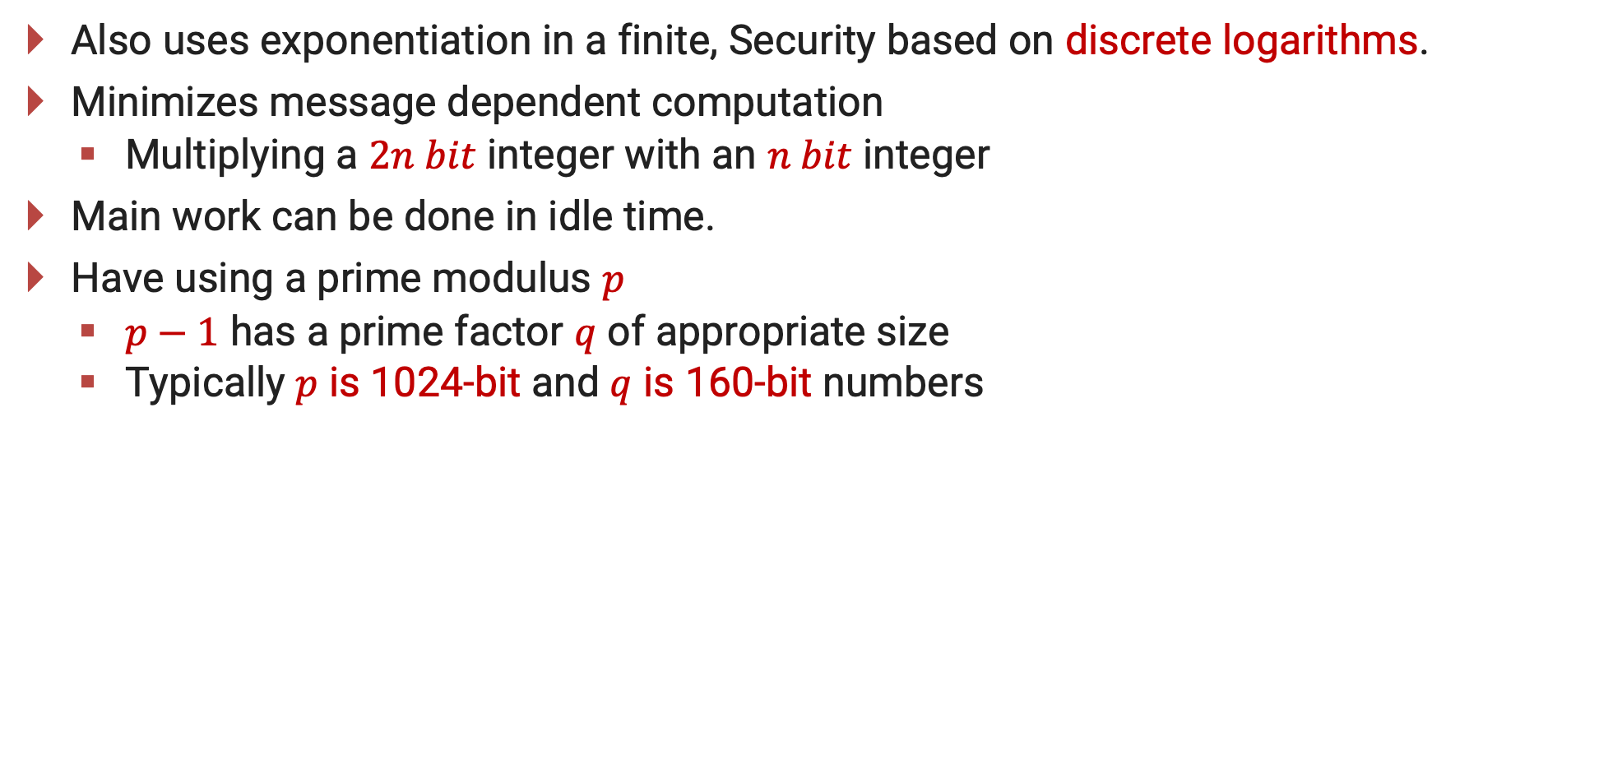
Schnorr Digital Signatures
Also uses exponentiation in a finite, Security based on discrete logarithms.
Minimizes message dependent computation
Multiplying a $2n bit$ integer with an $n bit$ integer
Main work can be done in idle time.
Have using a prime modulus $p$
$p−1$ has a prime factor $q$ of appropriate size
Typically $p$ is 1024-bit and $q$ is 160-bit numbers
Notes:
As with the ElGamal digital signature scheme, the Schnorr signature scheme is based on discrete logarithms [SCHN89, SCHN91]. The Schnorr scheme minimizes the message dependent amount of computation required to generate a signature. The main work for signature generation does not depend on the message and can be done during the idle time of the processor. The message dependent part of the signature generation requires multiplying a 2n-bit integer with an n-bit integer. The scheme is based on using a prime modulus p, with p – 1 having a prime factor q of appropriate size; that is p – 1 = 1 (mod q). Typically, we use p approx 2¹⁰²⁴ and q approx 2¹⁶⁰. Thus, p is a 1024-bit number and q is a 160-bit number, which is also the length of the SHA-1 hash value.

Slide 46
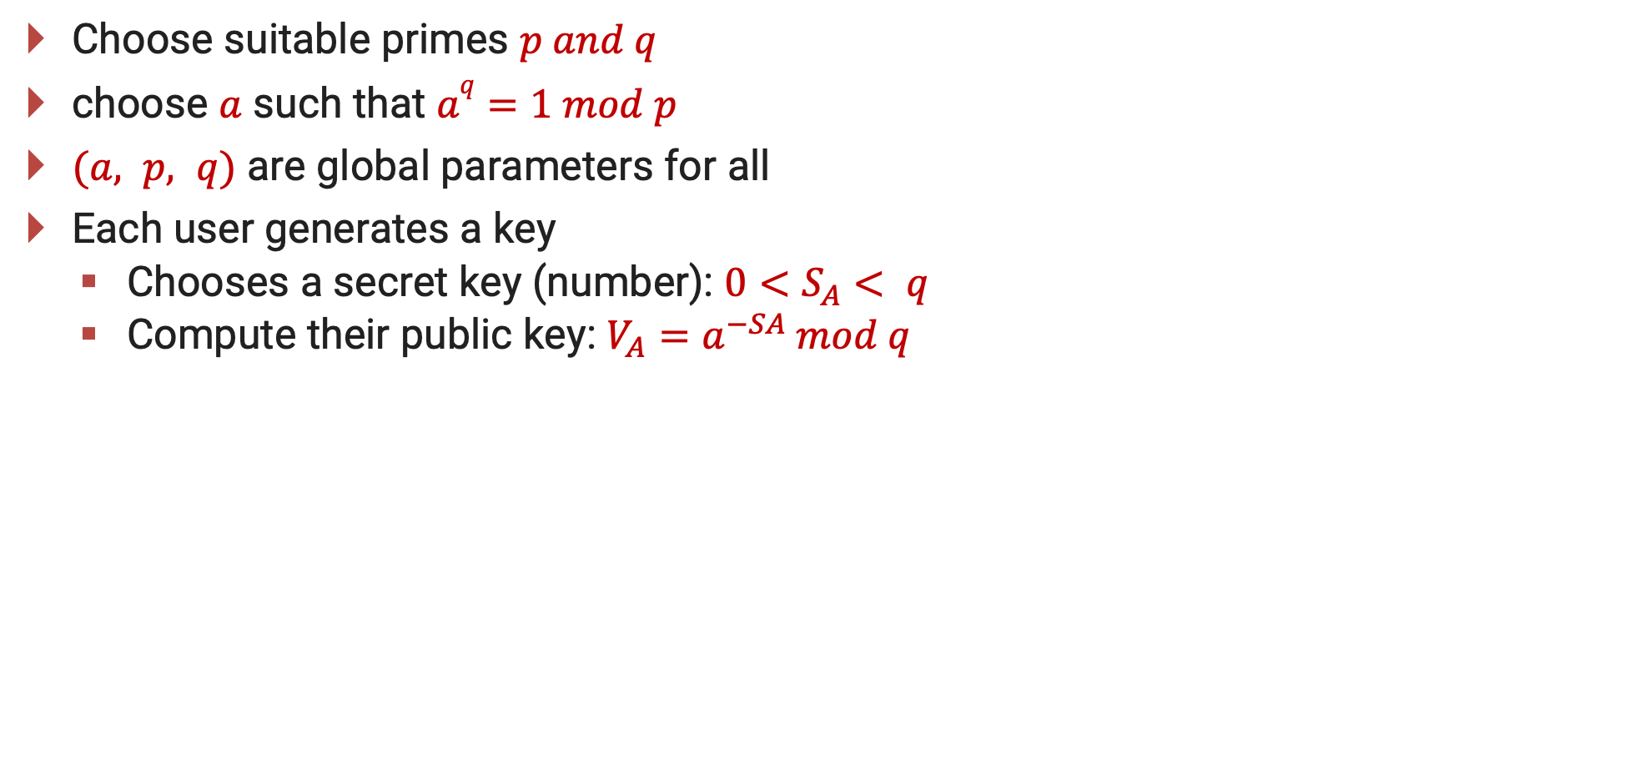
Schnorr Key Setup
Choose suitable primes $p and q$
choose $a$ such that $aq=1 mod p$
$(a, p, q)$ are global parameters for all
Each user generates a key
Chooses a secret key (number): $0<S_{A}< q$
Compute their public key: $V_{A}=a^{−SA }mod q$
Notes:
The first part of this scheme is the generation of a private/public key pair, which consists of the following steps:
Choose primes p and q, such that q is a prime factor of p – 1.
Choose an integer a such that a^{q} = 1 mod p. The values a, p, and q comprise a global public key that can be common to a group of users.
Choose a random integer s with 0 < s < q. This is the user's private key.
Calculate v = a^{–s} mod p. This is the user's public key.

Slide 47
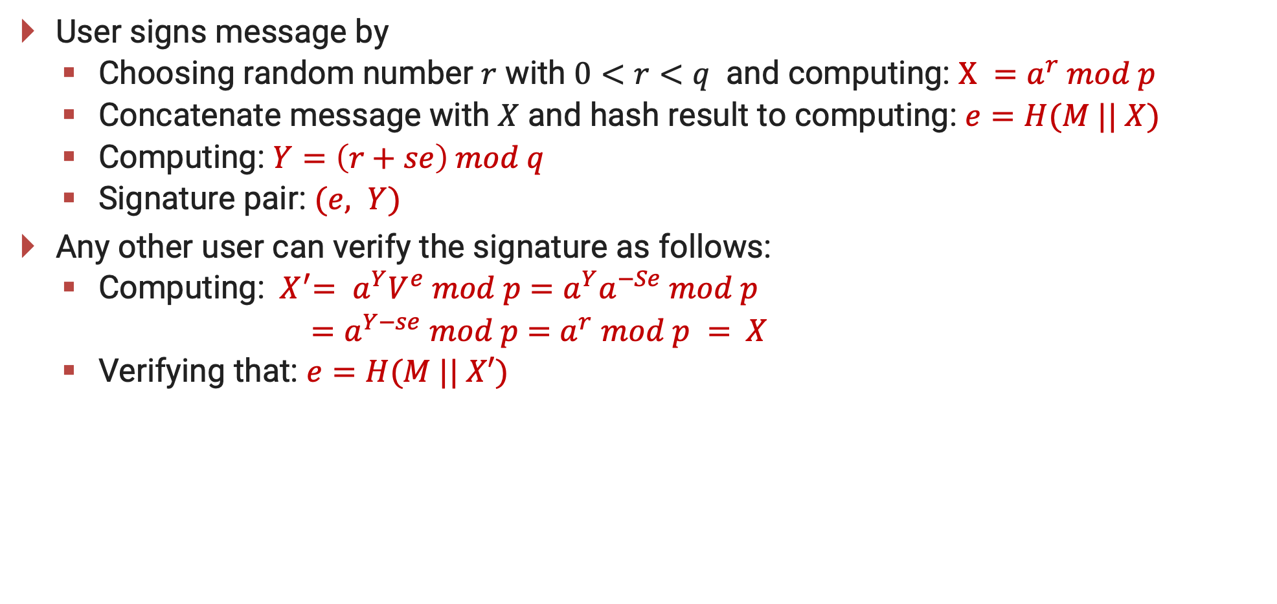
Schnorr Signature
User signs message by
Choosing random number $r$ with $0<r<q$ and computing: $X =a^{r} mod p$
Concatenate message with $X$ and hash result to computing: $e=H(M || X)$
Computing: $Y=\left(r+se\right) mod q$
Signature pair: $(e, Y)$
Any other user can verify the signature as follows:
Computing: ${ X}^{′}= a^{Y}V^{e} mod p$ $=a^{Y}a^{−Se} mod p$
$=a^{Y−se}$ $mod p$ $=$ $a^{r}$ $mod p$ $=$ $X$
Verifying that: $e=H(M || X′)$
Notes:
A user with public key s and private key v generates a signature as follows:
Choose a random integer r with 0 < r < q and compute x = a^{r} mod p. This is independent of any message M, hence can be pre-computed.
Concatenate message with x and hash result to compute: e = H(M || x)
Compute y = (r + se) mod q. The signature consists of the pair (e, y).
Any other user can verify the signature as follows:
Compute x' = a^{y}v^{e} mod p.
Verify that e = H(M || x').
See text for details of why the verification works.

Slide 48
Information & Network Security (INS)
DU #2101CS622
Prof. Maulik D Trivedi
Computer Engineering Department
maulik.trivedi@darshan.ac.in
9998 265 805

